Slide 1
Data Visualization in R
Price index time series
Michael Jadoo
Economist
OPT
CPI Data Huddle

Slide 2
Agenda
Intro to R
Data Visualization
Time Series Plots of Price index
Summary

Slide 3
Intro to R
Used for data manipulation and numerical calculations, specially statistical applications. Its strength is in the large number of specially built-in statistical functions.
Freely available
Work in an environment called Workspace that contains objects (which are easily accessible) that are ready to be called on to perform tasks.
R Studio is an IDE – Integrated Development Environment.
More user friendly environment.

Slide 4
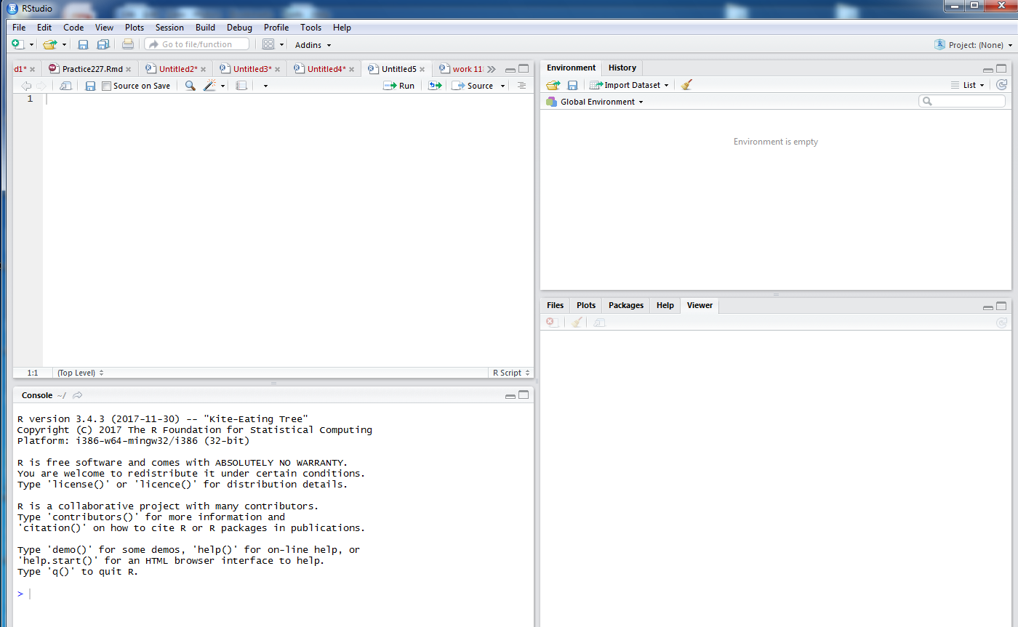
Script window
Environment/ History
Console

Slide 5
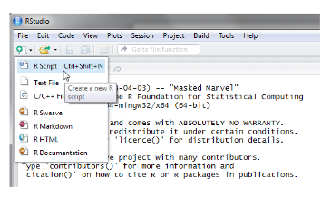
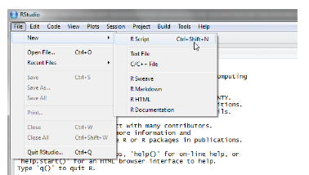
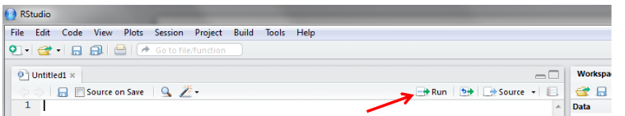
To create a new R script you can either go to File -> New-> R Script
, or click on the icon with the “+” sign and select “R Script”, or simply press Ctrl+Shift+N.
To run lines of code leave the cursor anywhere on the line where the code is and click on “Run” or “ press Ctrl +Enter

Slide 6

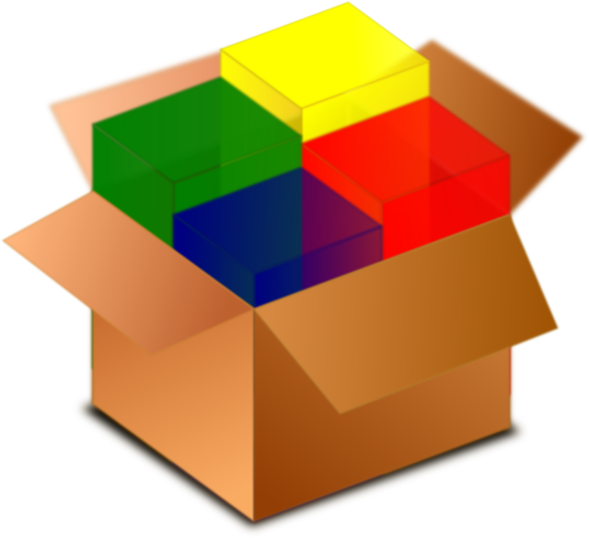

Functions and Packages
Packages are collections of functions and data sets developed by R users in the community
Package
Functions

Slide 7
Functions
A function is a set of statements organized together to perform a specific
task. R has a large number of in-built functions and the user can create their
own functions.
Function Components
Function Name
Arguments
Function Body
Return Value
times <- function(x,y) {
x*y
}
times(2,4)
8

Slide 8
Packages
install.packages(" dplyr ") library("dplyr ")
install.packages(c("dplyr", "ggplot2"))
library("dplyr")
library("ggplot2")

Slide 9
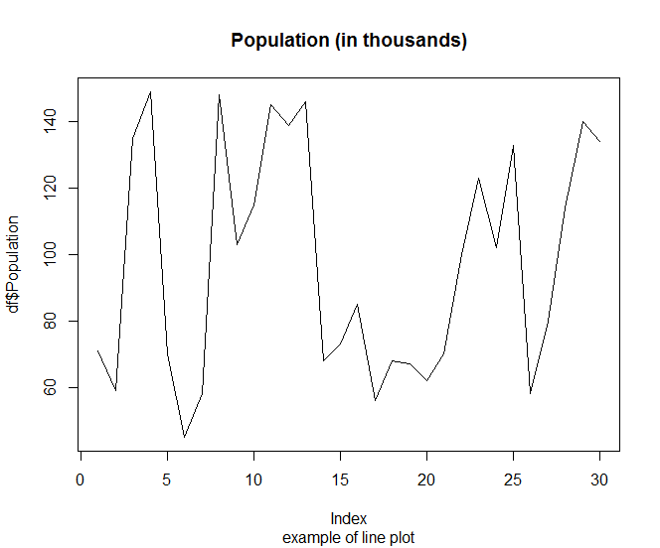
Data visualization
Bar Plot
Line Chart

Slide 10
Data Visualization
Bar Plot
Line Chart
Emphasizes discrete categories, and each bar is of equal width
Can see which groups are highest or most common, and how other groups compare against the others.
Display information in the form of series of data points over time
Useful to show data variables and trends very clearly
Experts recommend no more than 4 lines on a single graph; any more it becomes difficult to interpret.

Slide 11
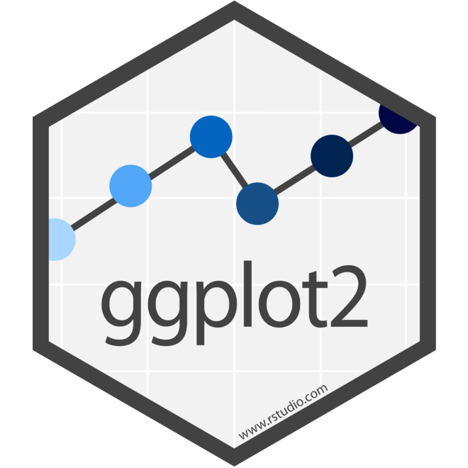
Package(s) used: GGPLOT2
Tidyverse, readxl, lubridate, zoo, dplyr, scales, cowplot, forcats, ggthemes

Slide 12
Packages used: GGPLOT2
ggplot2 is an R package for producing statistical, or data, graphics. Unlike most other graphics packages, ggplot2 has an underlying grammar, based on the Grammar of Graphics, that allows you to compose graphs by combining independent components.

Slide 13
CPI-U
The Consumer Price Index (CPI) is a measure of the average change over time in the prices paid by urban consumers for a market basket of consumer goods and services. Indexes are available for the U.S. and various geographic areas.

Slide 14
How its used
The official measure of inflation used by the Federal Reserve Board is the Price index of PCE but the CPI is still used as a comparison.
12-month rate of change
Fed Inflation target: 2% (12-month rate of change)

Slide 15

DEMO

Slide 16
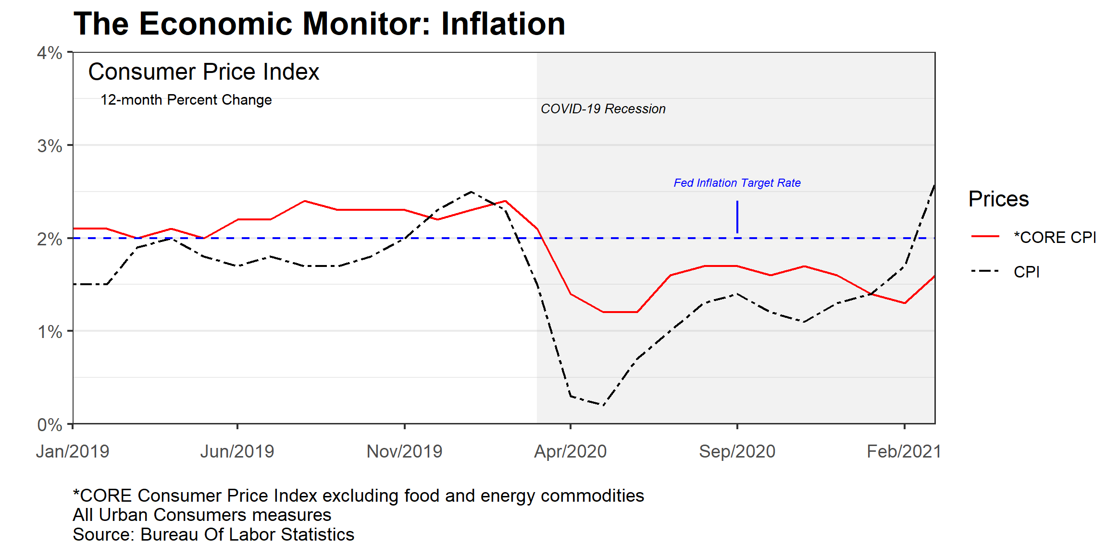
Review and Take away

Slide 17
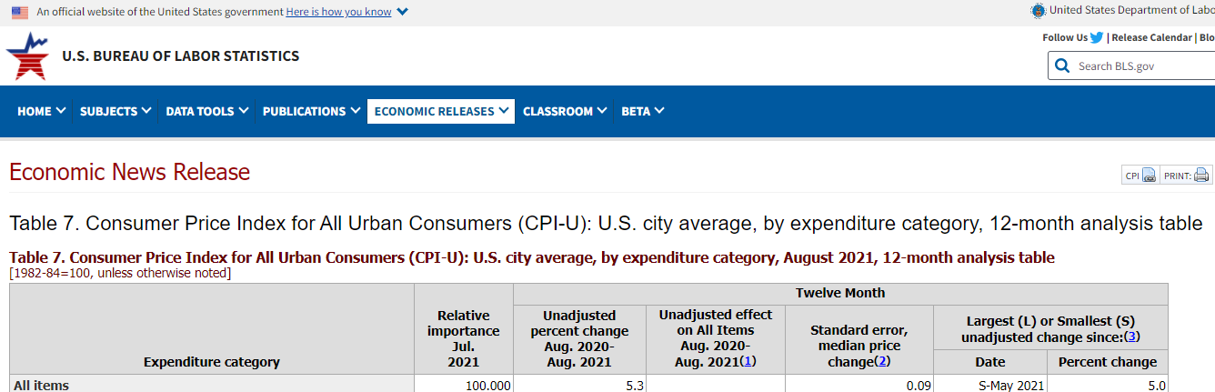
Table 7 Consumer Price Index

Slide 18
DEMO

Slide 19
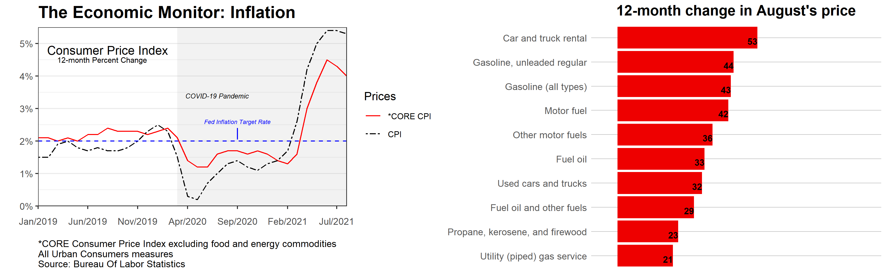
Review and Take away

Slide 20
Michael Jadoo
Economist
OPT
www.bls.gov/opt
Jadoo.michael@bls.gov

